Slide 1
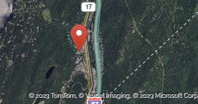
Tuxedo Revitalization Workshop Why Are We Here?

Slide 2
Hamlet Revitalization and Beautification
Cohesive, Achievable Plan to Incorporate:
Pedestrian Safety and Connectivity
Safety and Traffic Calming
Business District Parking Solutions
Beautification—Maintaining the Integrity of Tuxedo Character--
Lighting and Landscaping

Slide 3
Key Objectives Detailed In the Comprehensive Plan
Connectivity - Enhance the pedestrian access to the commercial district in the Hamlet from neighborhoods, and potentially Tuxedo Farms.
Public parking-- additional opportunities
Pedestrian Safety--Sidewalks, walkways and bike lanes
Streetscapes—Lighting and Landscape options
Beautification--shrubbery, signage, benches, bike racks

Slide 4
Tuxedo Local Development Corp Objectives
Beautification of Commercial District
Value Added Projects to Attract New Businesses
Walkable business district with enhanced parking options
Streetscape Beauty – Landscaping and Architectural Elements
Restoration of Historical Buildings and Tuxedo Character

Slide 5
Tuxedo LDC Activities To Date
Tuxedo Hudson –IGA Building
Steve’s Pizza
Historical Society
Orange Top
Karyn Building
Tuxedo Train Station-Renovation and Maintenance
Tuxedo Rt 17 Bus Stop
$ 1.5 million Dollars in LDC Grants Funded By Related

Slide 6
Tuxedo Hamlet Revitalization Plan
Town Initiative:
* Enhance the Physical Appearance of the Downtown Business District
*Add value to current pedestrian walkways providing connectivity and safety
*Adhere to NYS DOT specifications, MTA plans and current changes in traffic patterns
*Develop a collaborative plan to incorporate and support Tuxedo LDC projects currently underway
*Utilize the Comprehensive Plan as a guide

Slide 7
Tuxedo Revitalization Program– Challenges
Rt 17 is Tuxedo’s “Main Street”
All Modifications Along Rt 17 Are Subject to NYS DOT Approval
DOT “Right of Way” Abuts Private Property
Absence of a Survey
Funding Challenges

Slide 8
NYS DOT Specifications
DOT Owns Right of Way
Town Responsible for Maintenance
All New Construction Requires Survey, Engineering Drawings and Permit
New Sidewalks Min of 5 ft
Lighting/Landscaping Min Additional 2 ft per element

Slide 9
Tuxedo Town Outreach
Market Research– Businesses and Residents
Safety—Pedestrian Barriers—Traffic Calming Measures
Lighting
Connectivity
Streetscape Beauty – Landscaping and Architectural Elements

Slide 10
Rt 17 East Side Existing Conditions and Options
East Side Rt 17 Hamlet
-8ft+ sidewalks
-Lease option for additional parking
-Connectivity to municipal parking and train station
-Current LDC Projects

Slide 11
Hamlet Revitalization Plan—East Side Rt 17
Beautification
Connectivity
Safety and Traffic Calming
Parking Solutions

Slide 12
Tuxedo Rt 17 East Side
Section 1
East Village Road to the Train Station

Slide 13
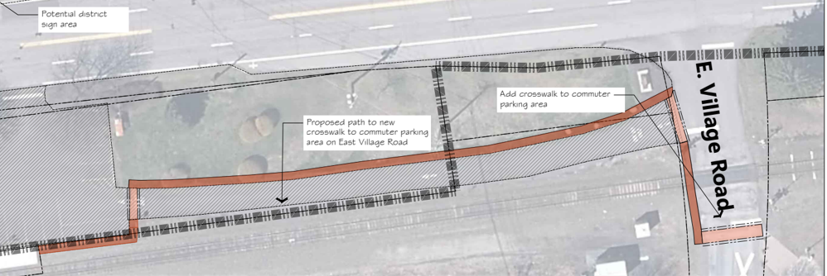

Slide 14
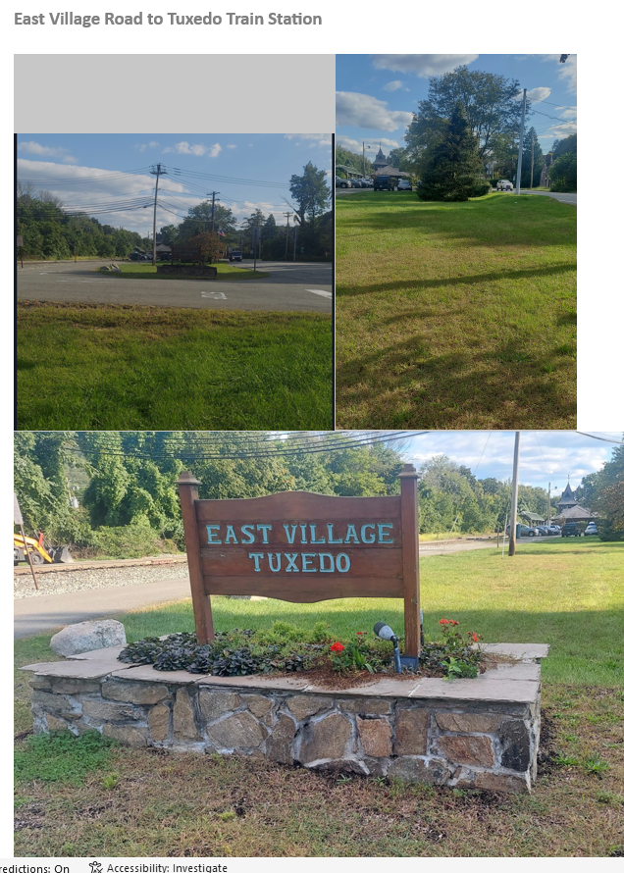

Slide 15
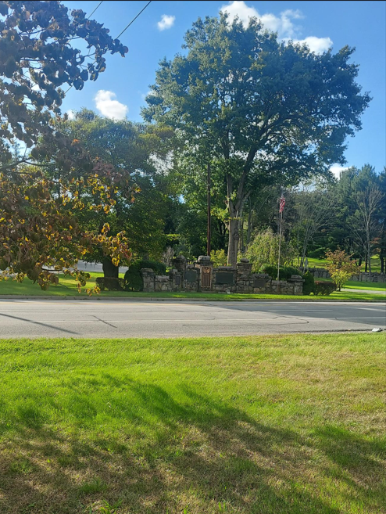

Slide 16
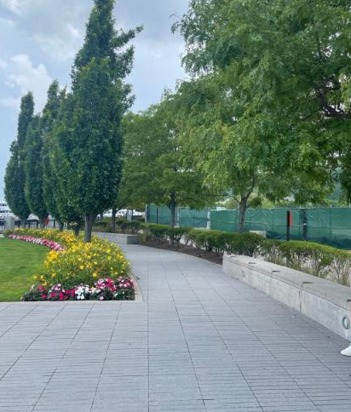
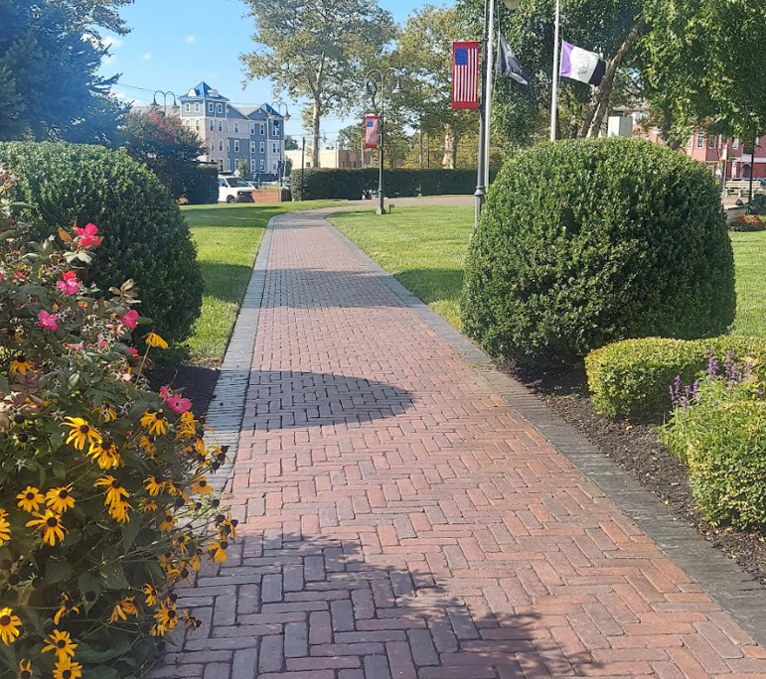
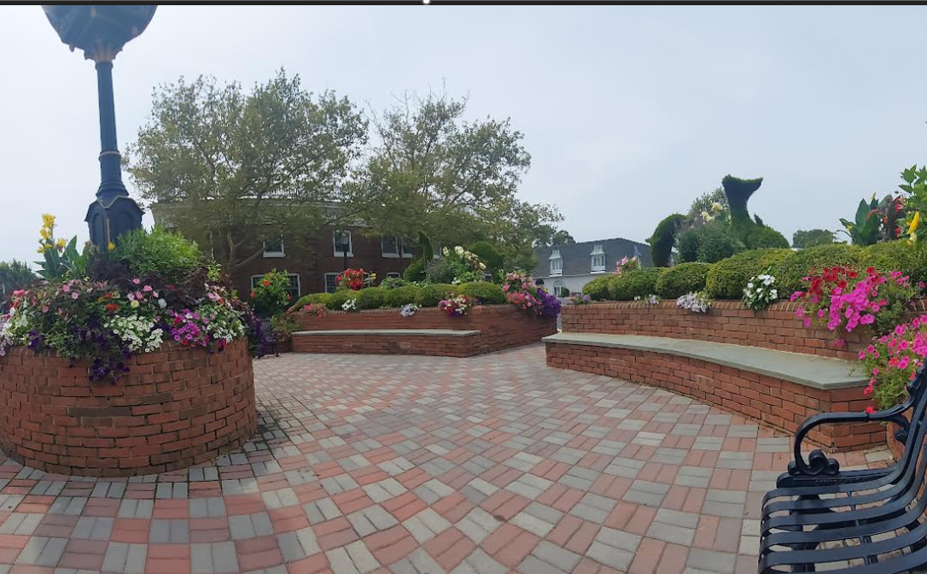

Slide 18
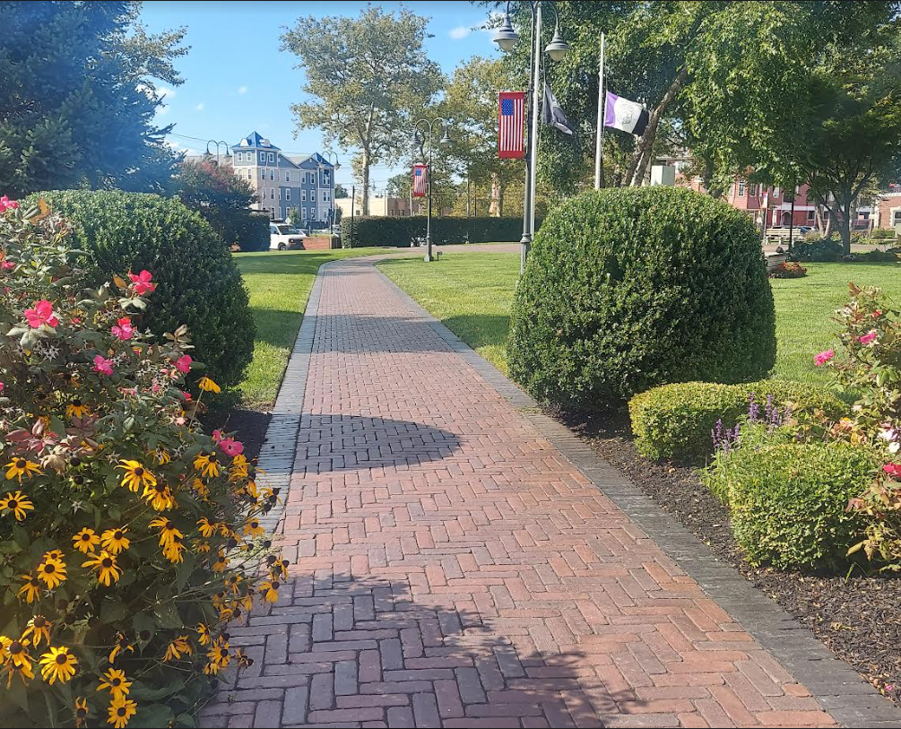

Slide 19
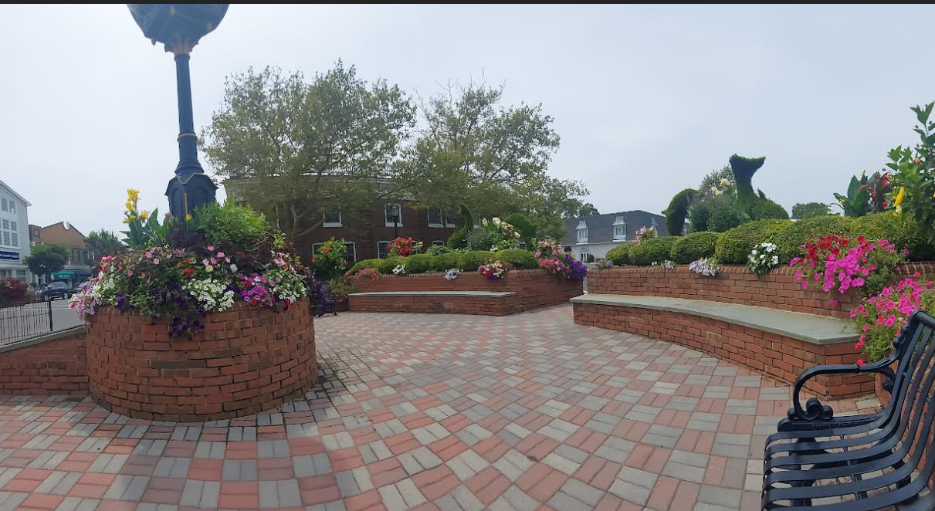

Slide 20
Tuxedo Rt 17 East Side
Section 2
Train Station Parking Lot

Slide 22
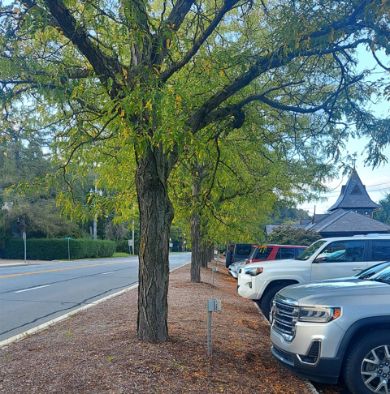
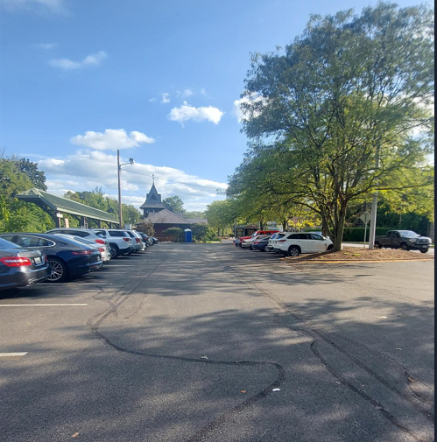

Slide 23
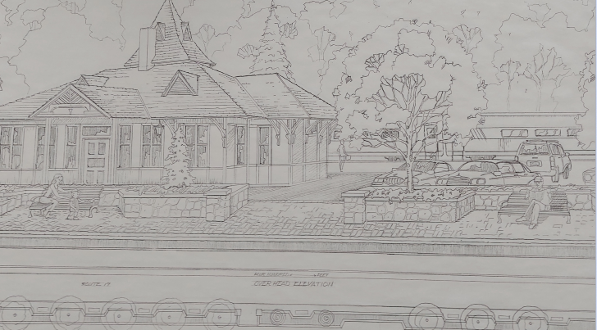

Slide 24
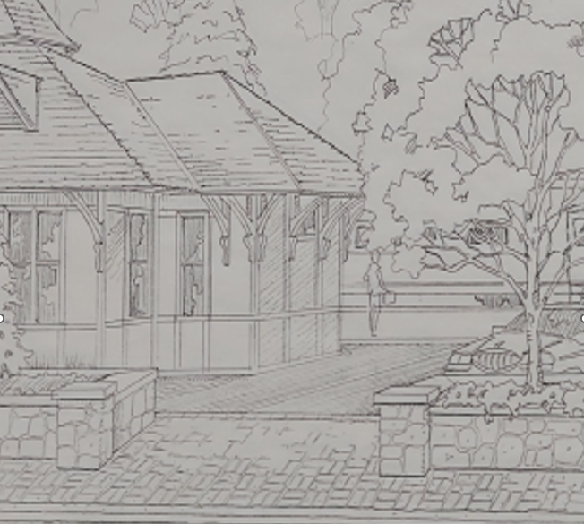

Slide 25
Notes:
Add Train station Photo

Slide 26
Tuxedo Rt 17 East Side
Section 3
Post Office and Retail Store Parking Lot

Slide 28
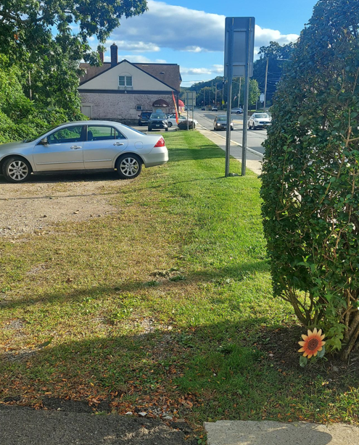
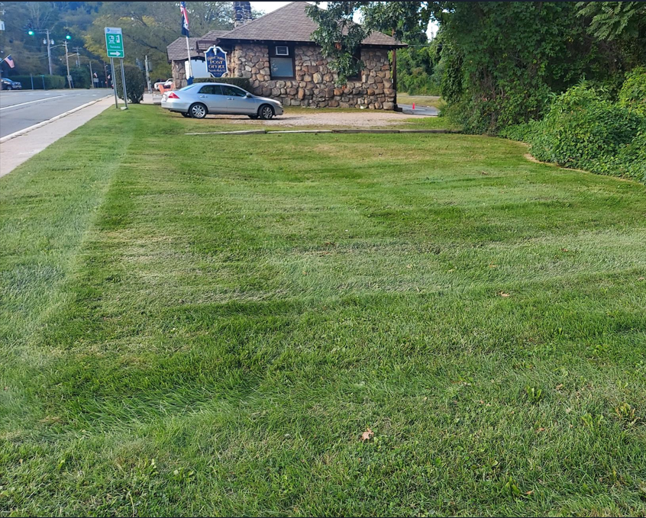

Slide 29
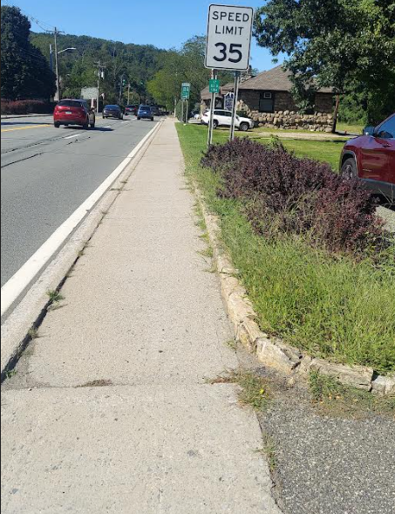
Parking Solutions—Post Office Lot
Connecting Sidewalk to meet DOT Specs
Additional Parking
Landscaping and Beautification

Slide 30
Tuxedo Rt 17 East Side
Sections 4 and 5
Retail Businesses to Orange Top

Slide 31
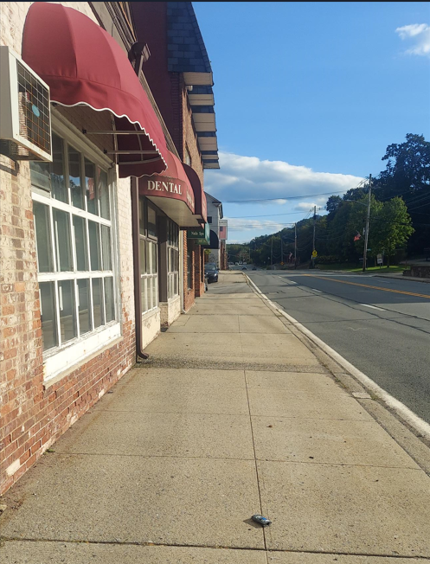
East Rt 17 Corridor
Retail District
8-9 ft Sidewalks

Slide 32
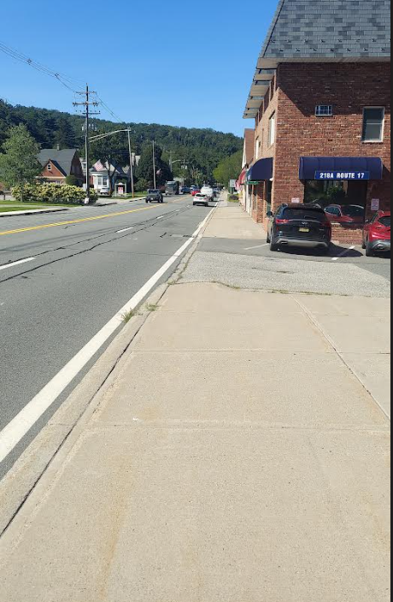
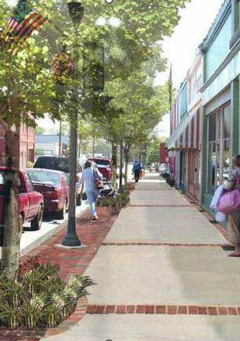
Connectivity and Sidewalk Solutions
8 ft+ sidewalks
Complete Street Concepts Achievable

Slide 33
Conceptual Sidewalk Pavement Plan

Slide 34
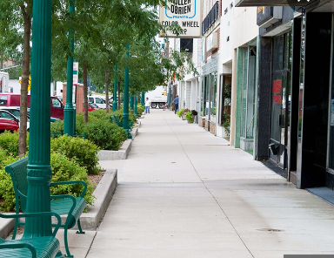

Slide 35
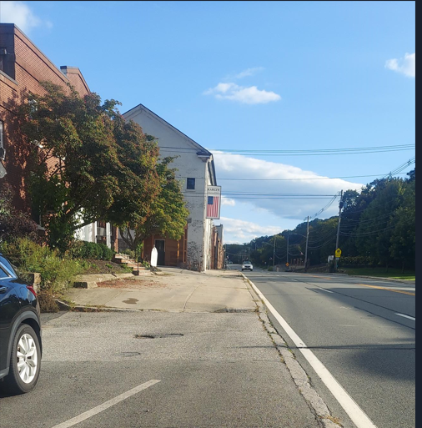
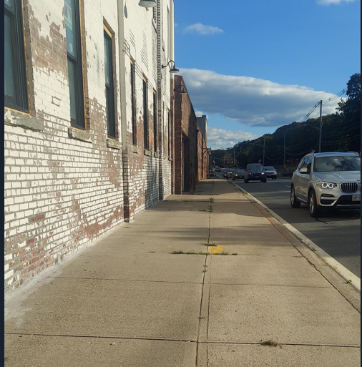

Slide 36
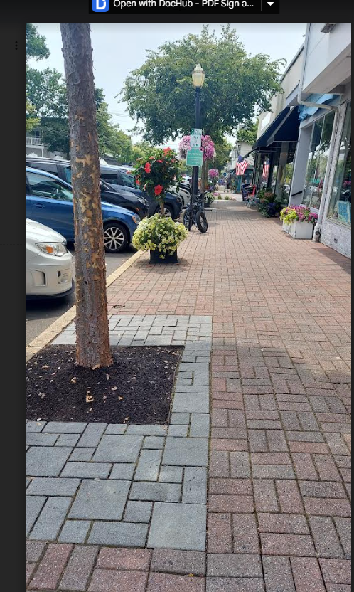

Slide 37
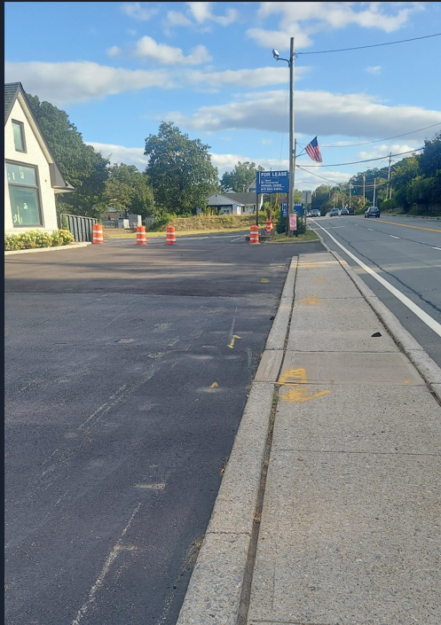
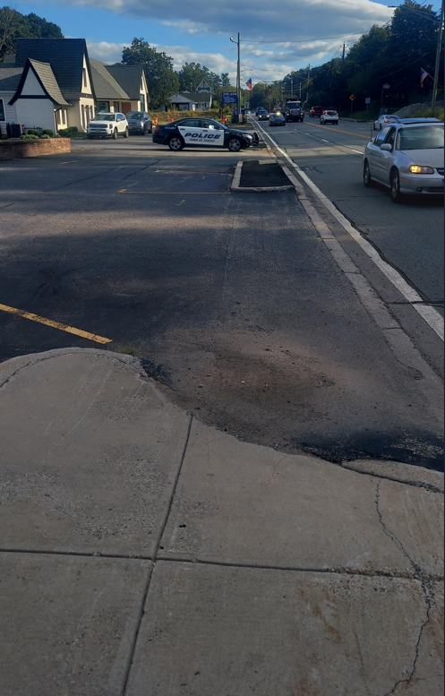
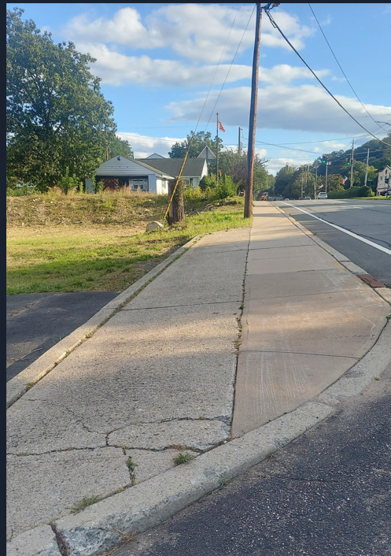

Slide 38
Rt 17 Safety and Traffic Calming
Section 6

Slide 39
Safety and Traffic Calming
Crosswalk at Hospital Road
-Connecting East and West Business District
Traffic Calming
School Safety

Slide 40
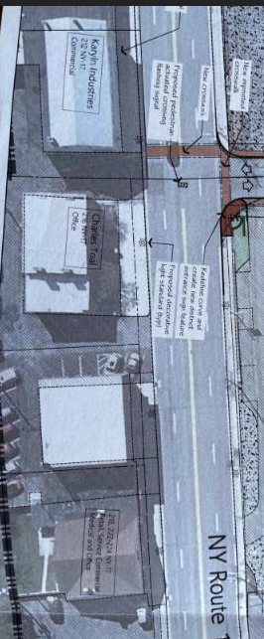

Slide 41
MTA Update
Section 7

Slide 42
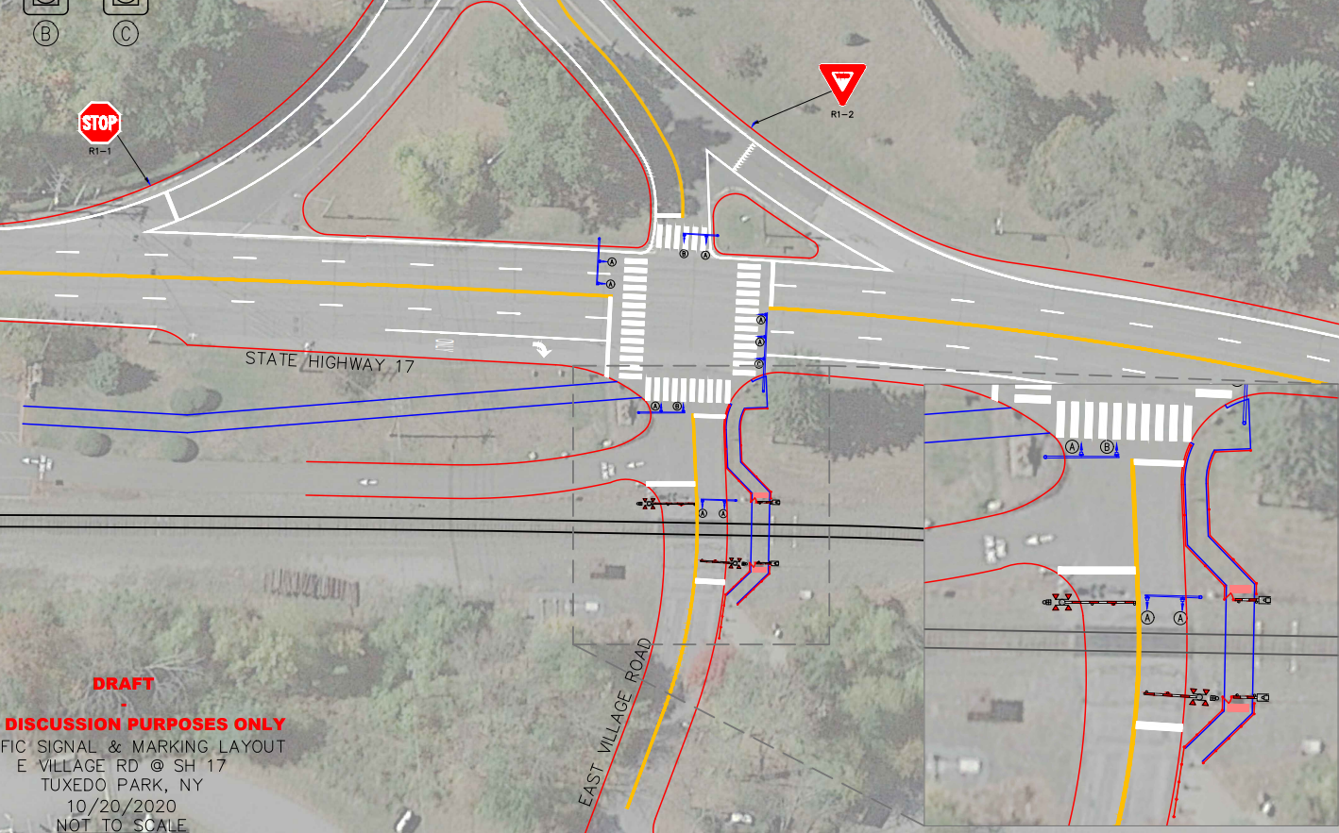

Slide 43
Summary
We Need A Plan
We Need Consensus
We Need Funding
There is NO Funding Without a Plan or Consensus

Slide 44
Next Steps
Consensus
Hamlet Revitalization Workshops
Action Steps
Survey
Engineering and Architectural Landscape Plans
East and West Rt 17
Complete Hamlet Plan

Slide 45
Next Workshop
Rt 17 West Side Challenges and Options
Pedestrian Safety and Connectivity
Town Owned Streets—Opportunities and Beautification
Parking Opportunities
Road Diet Review
Thank You For Your Attention and Feedback!

